Slide 1
Date:
Programming for Analytics
(Python)
Project name:
Airport Data Visualizations
Team 9:
1. Nirja Rajeev – 2024H1540801P | 3. Sarvesh Kulkarni – 2024H1540820P
2. Satheesh M K – 2024H1540810P | 4. Saket Pitale – 2024H1540836P
Department of Management

Slide 2
INTRODUCTION
Dataset Focus:
The project uses the International Airports Dataset, offering a comprehensive overview of global airports.
Dataset Highlights:
The following CSV files were used in our analysis
1. airports.csv
2. countries.csv
3. navaids.csv
4. regions.csv
5. runways.csv
Objective:
To extract and visualize meaningful insights from these datasets using Python.

Slide 3
PROJECT FLOW
Understanding the Datasets
Deciding the Visualizations
Checking the feasibility of the visualizations
Writing the code
Data Cleaning
(Removing Nulls and blanks)
Importing necessary Libraries
Drawing conclusions and interpretations from the visuals
Create and upload the code to GitHub repo

Slide 4

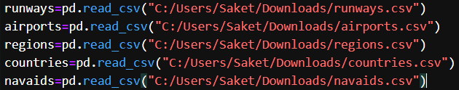
SETUP
Importing the Libraries: Importing Datasets:
Data Cleaning:

Slide 5
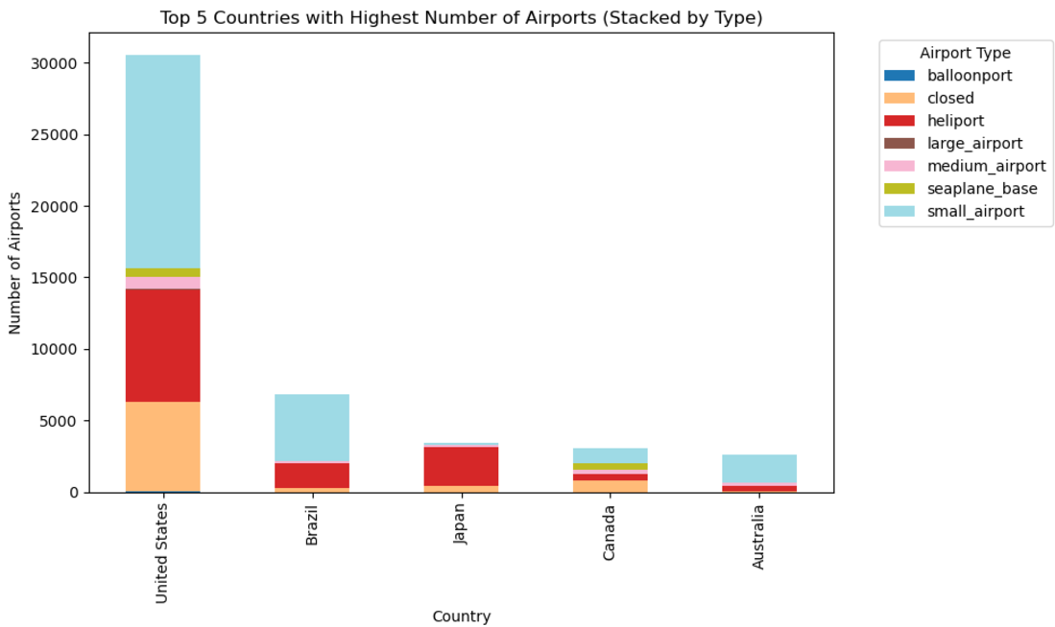
1. STACKED BAR GRAPH

Slide 6
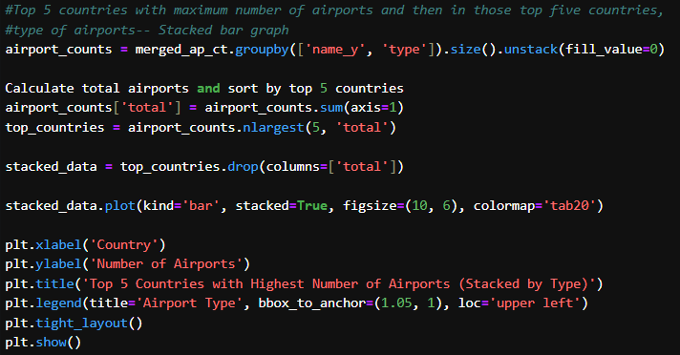
1. STACKED BAR GRAPH
Flow of the code:
Grouping Data -> Calculate Totals-> Filter Top 5 Countries -> Prepare Data for Plotting -> Plot Stacked Bar Graph
Code Snippet:
Description and Purpose:
The stacked bar graph shows the Top 5 countries with the most airports, categorized by airport types (e.g., small, medium, large).
To compare the number and type of airports across the top 5 countries with the largest aviation networks.`

Slide 7
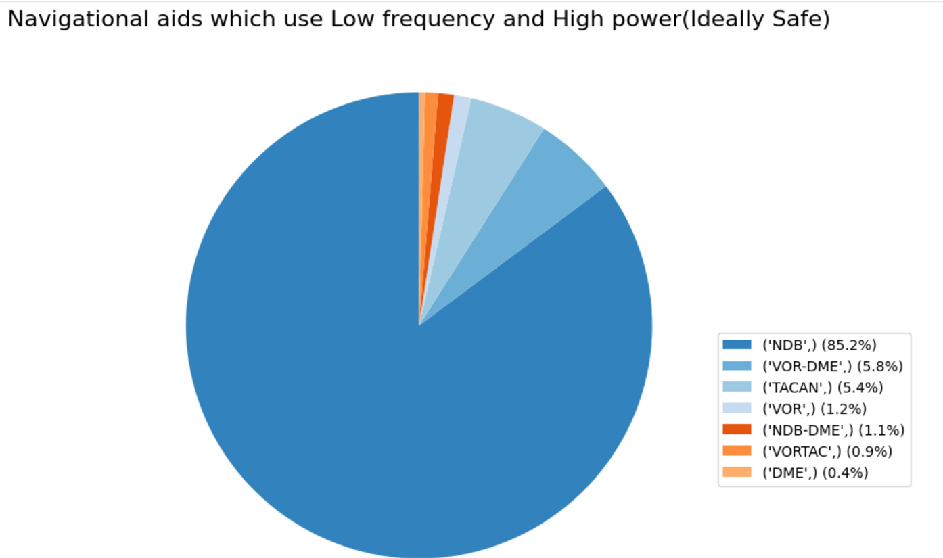
2. PIE CHART

Slide 8

2. PIE CHART
Code Snippet:
Flow of the code:
Filter Data -> Sort and Select Top 1000 -> Count Types -> Calculate Percentages -> Prepare Legend Labels -> Plot Pie Chart
Description and Purpose:
The pie chart visualizes the distribution of navigational aid types using high power and low frequency, representing their role in safe and secure landings.
To highlight the proportion of each type of navigational aid among the safest options for guiding aircraft landings.

Slide 9
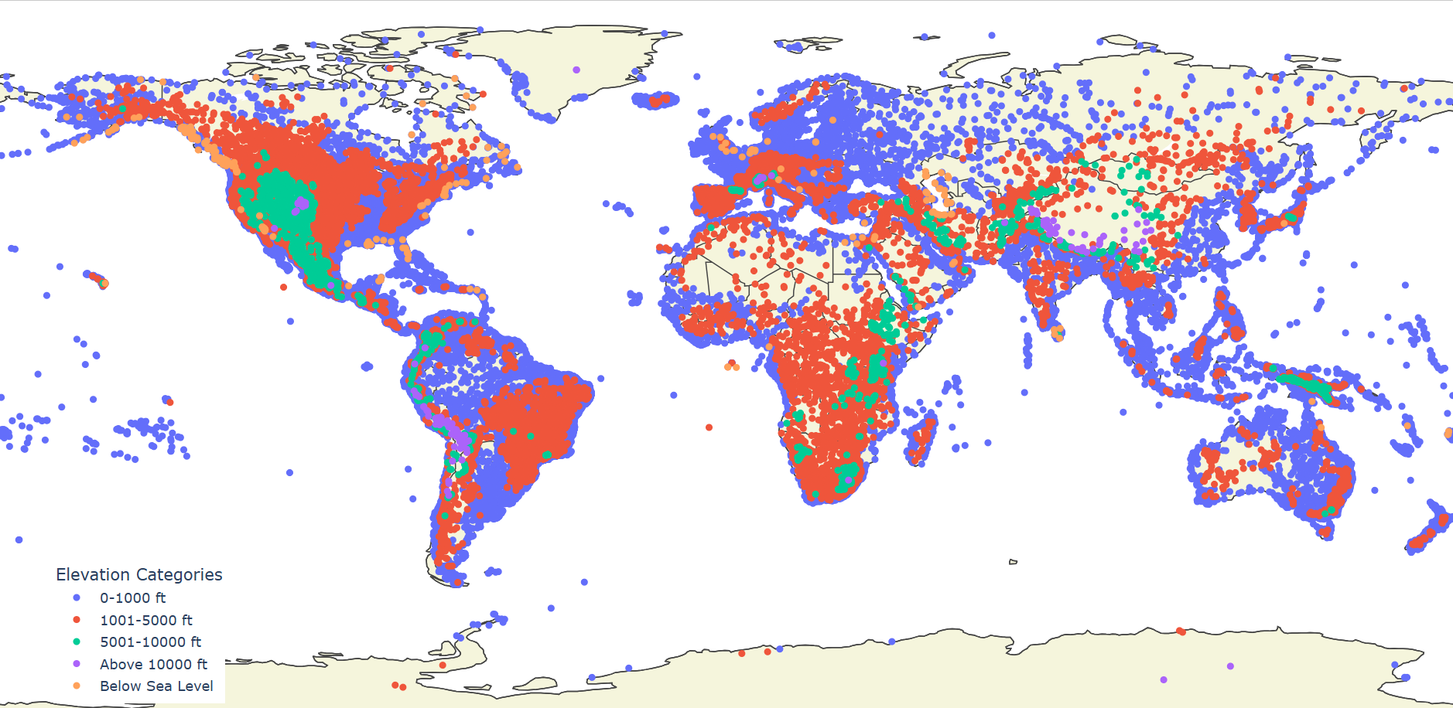
3. WORLD MAP

Slide 10
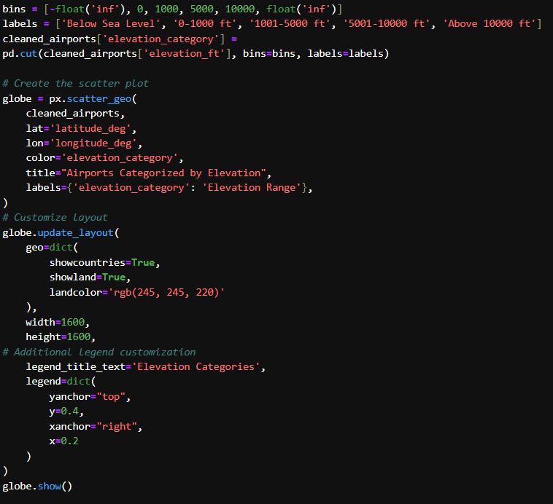
3. WORLD MAP
Code Snippet:
Flow of the code:
Define Elevation Categories -> Assign Categories to Airports -> Plot Scatter Geo Map -> Customize Layout and Legend -> Display Map
Description and Purpose:
The scatter geo map shows airports categorized by their elevation, with distinct colors representing different elevation ranges on a global map.
To visualize the geographical distribution of airports based on elevation, providing insights into their location relative to sea level.

Slide 11
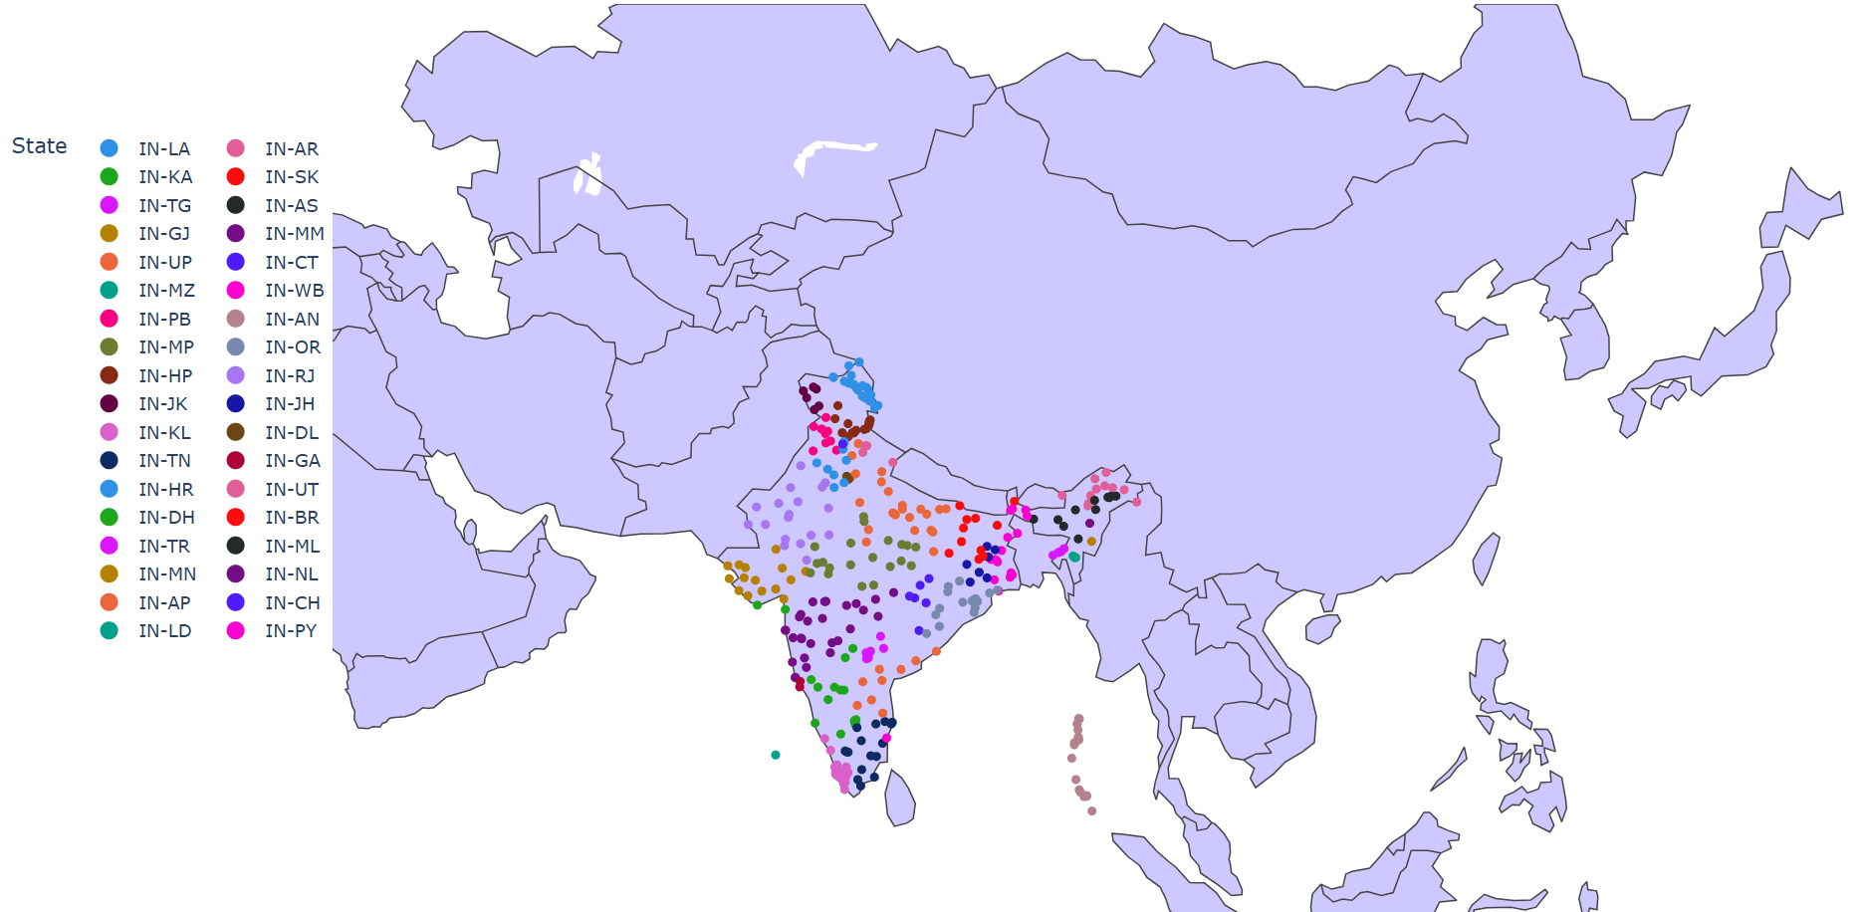
4. INDIA MAP

Slide 12
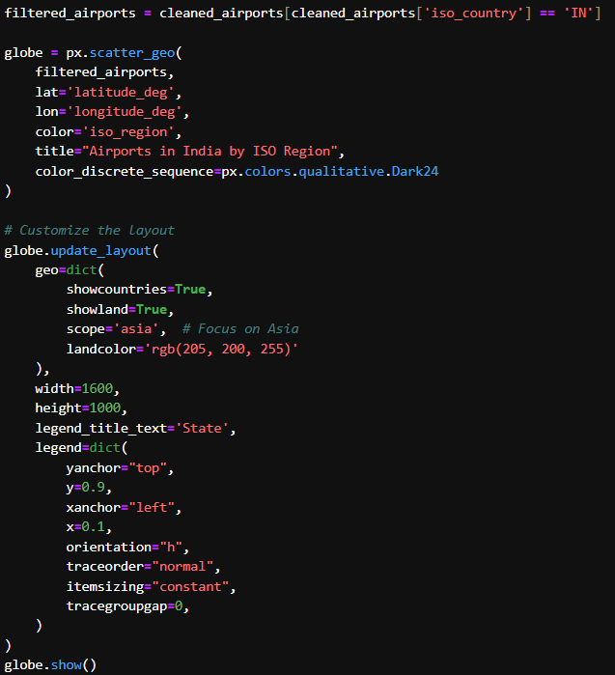
4. INDIA MAP
Code Snippet:
Flow of the code:
Filter Airports in India -> Plot Scatter Geo Map -> Customize Layout -> Display Map
Description and Purpose:
The scatter geo map visualizes the airports in India, categorized by their ISO regions, with each state represented by a distinct color.
To analyze and showcase the geographical distribution of airports across different states and regions within India.

Slide 13
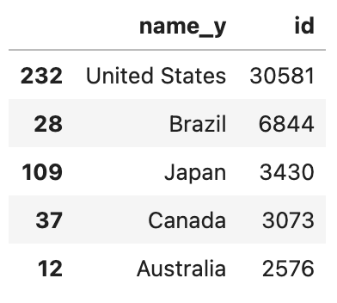
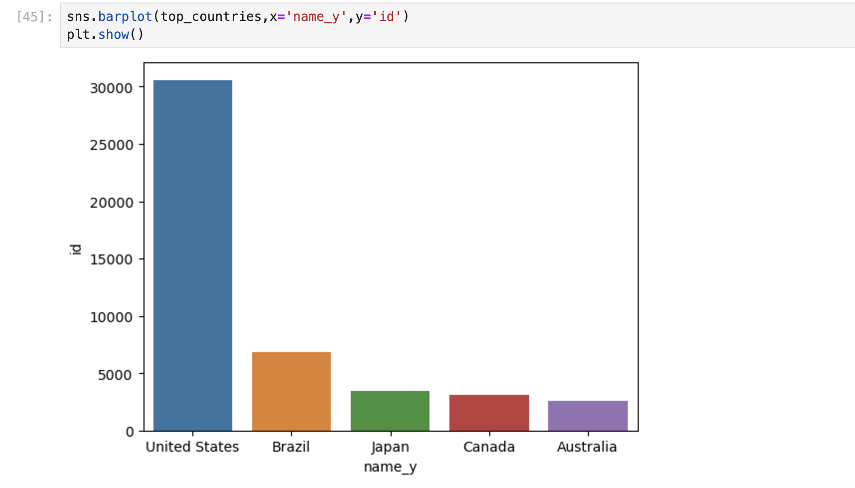
5. TABLE & BARGRAPHS

Slide 14
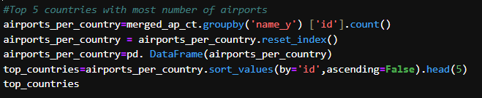

5. TABLE & BARGRAPHS
Code Snippet:
Flow of the code:
Group Data by Country -> Count Airports per Country -> Reset Index -> Create DataFrame -> Sort by Number of Airports -> Select Top 5 Countries
Description and Purpose:
This code identifies the Top 5 countries with the highest number of airports by counting airports per country from the dataset.
To rank countries based on the size of their airport networks and highlight the top-performing nations in aviation infrastructure.

Slide 15
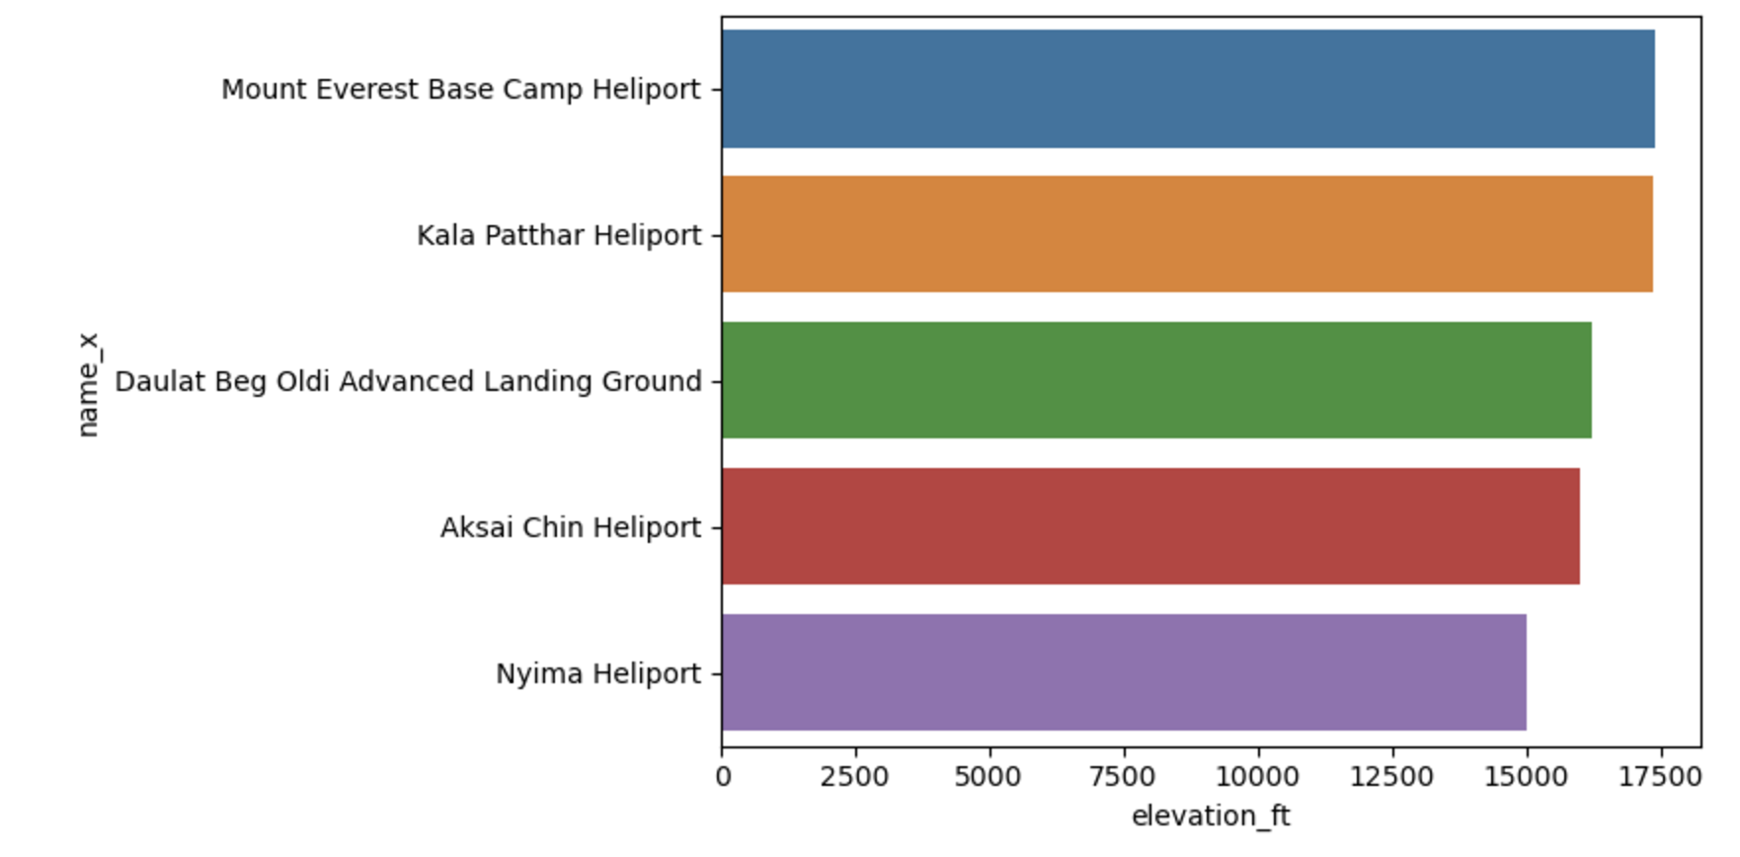
6. BARPLOTS

Slide 16

6. BARPLOTS
Code Snippet:
Flow of the code:
Sort Airports by Elevation -> Select Top 5 Elevated Airports -> Plot Bar Graph
Description and Purpose:
The bar graph shows the Top 5 highest elevated airports, with their elevation in feet displayed along the x-axis.
To identify and visualize the airports located at the highest altitudes globally.

Slide 17
CONCLUSION
Top 5 Countries with Airports: Highlights countries with the most airports, showcasing global aviation leaders.
Airport Types by Country: Displays the distribution of airport types in the top 5 countries.
Top 5 Elevated Airports: Identifies airports at high altitudes, essential for special aviation protocols.
Navigational Aids: Highlights the role of high-power, low-frequency navigational aids in safe landings.
Airports in India: Maps the geographical distribution of airports across Indian regions, showing regional connectivity.

Slide 18
THANK YOU

